Slide 1

Marketing Strategy for European Expansion
Gregory Rankel

Slide 2

Agenda
MLS Popularity
Problem Statement
Data
Word Counts – Count Vectorizer and Tfidf Vectorizer
Model Selection
Model Evaluation
Coefficients
Confusion Matrix
Distribution of NFL and Football
Receiver Operating Characteristics Curve
Conclusion

Slide 3
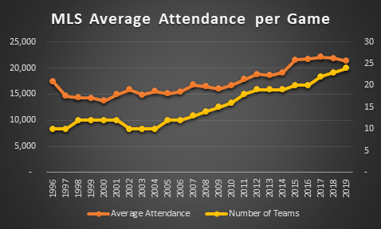
MLS Expansion
Currently ended 2019 with 24 teams with Inter Miami CF and Nashville SC set to join the league in 2020, while Austin FC comes on board a year later
40% increase in MLS interest in Orlando, Atlanta, and Minnesota since 2012

Slide 4
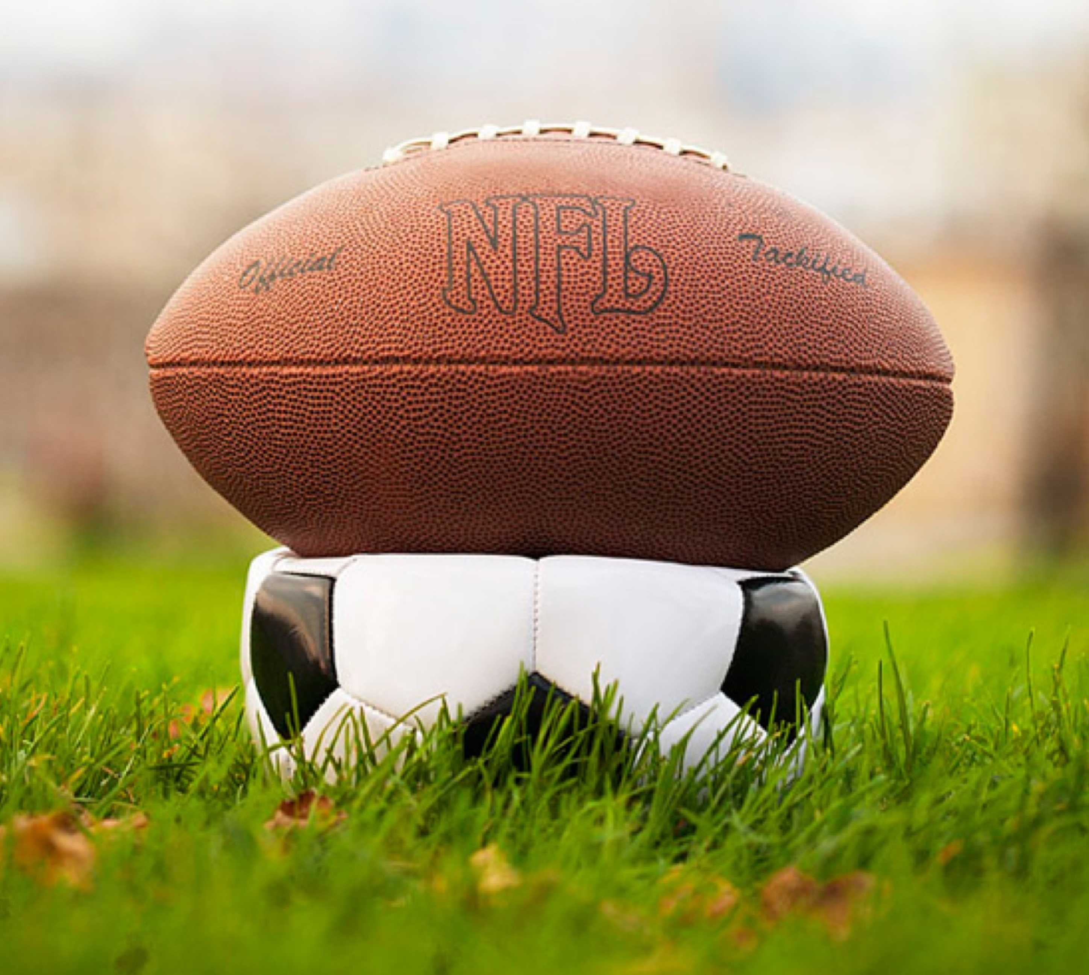
Problem
Football?

Slide 5
Data
4,692 Data Points from the NFL and Football Reddit
Dropped Unnecessary Columns and Duplicates
Remove Stop Words
Porter Stemmer Words
Map NFL and Football subreddits as 0 and 1 respectively

Slide 6
Most Common Words: Count Vectorizer

Slide 7
Most Frequent Words: Tfidf Vectorizer

Slide 8
Baseline Model Score
~61%
Total NFL Reddit’s comments pulled: 2,859
Total Football Reddit’s comments pulled: 1,833

Slide 9
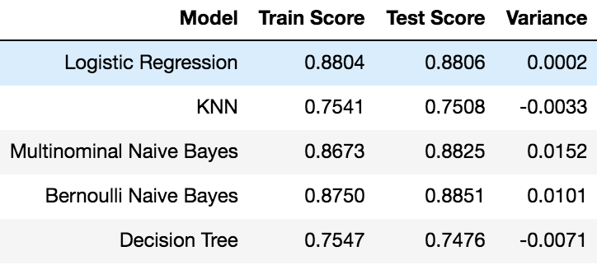
Model Selection: FeaturedUnion +Logistic Regression

Slide 10
Coefficients

Slide 11
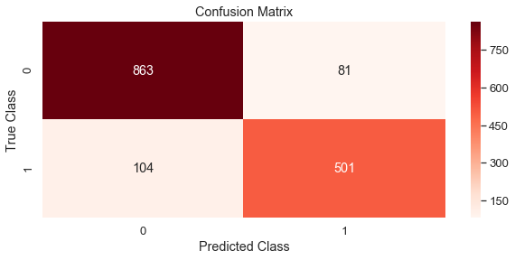
Confusion Matrix
Accuracy
88.1%
Misclassification
Sensitivity:
Specificity:
11.9%
82.8%
91.5%

Slide 12
Distribution: NFL and Football

Slide 13
ROC Curve and ROC AUC Score
ROC AUC Score
94.7%

Slide 14
Conclusion and Next Steps:
Model Selection: FeaturedUnion +Logistic Regression
High Bias- 88.04% Train Score
Low Variance- .02%
Confusion Matrix Scores:
Accuracy : 88.1%
Misclassification: 11.9%
Sensitivity: 82.8%
Specificity : 91.5%
ROC Score: 94.7%
Next Steps: Would like to test other types of blogs to see if similar words would pop up before rolling out model in Campaign

Slide 15

Questions
This Photo by Unknown Author is licensed under CC BY-SA

Slide 16
References
https://www.nielsen.com/us/en/insights/article/2019/football-fever-is-spreading-as-major-league-soccer-kicks-off-a-new-season/
https://www.schneiderdowns.com/our-thoughts-on/growth-of-soccer-in-america

